Slide 1
TITLE
An insight customers reviews

Slide 2
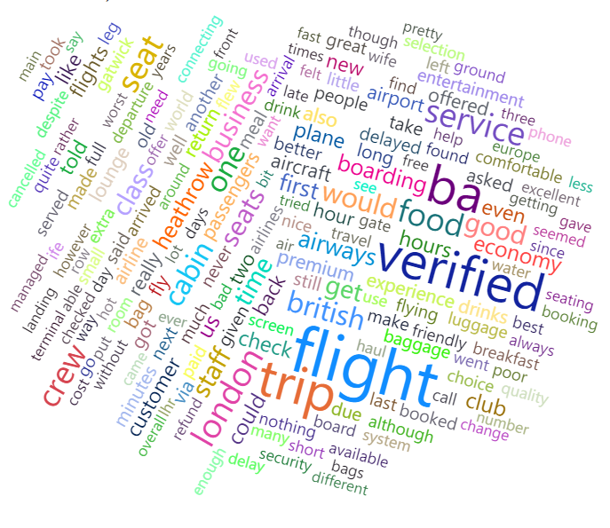
From the word could some words appeared most and services connected to these words needs to be checked. some of which are verified, London, flight, crew, etc.
Other words like time, economy, seat, cabin, and food needs to be looked into
Positive words seen like good was many as compared to excellent, better, and best
Some negative words were seen but didn’t have much frequency: delay, refund, bad and poor.

